Slide 1
VTC2019-Fall Awards Luncheon
Provided by: VTS Conference Administration

Slide 2
Notes:
J.R. Cruz, VP of Conference for the IEEE Vehicular Technology Society.

Slide 3
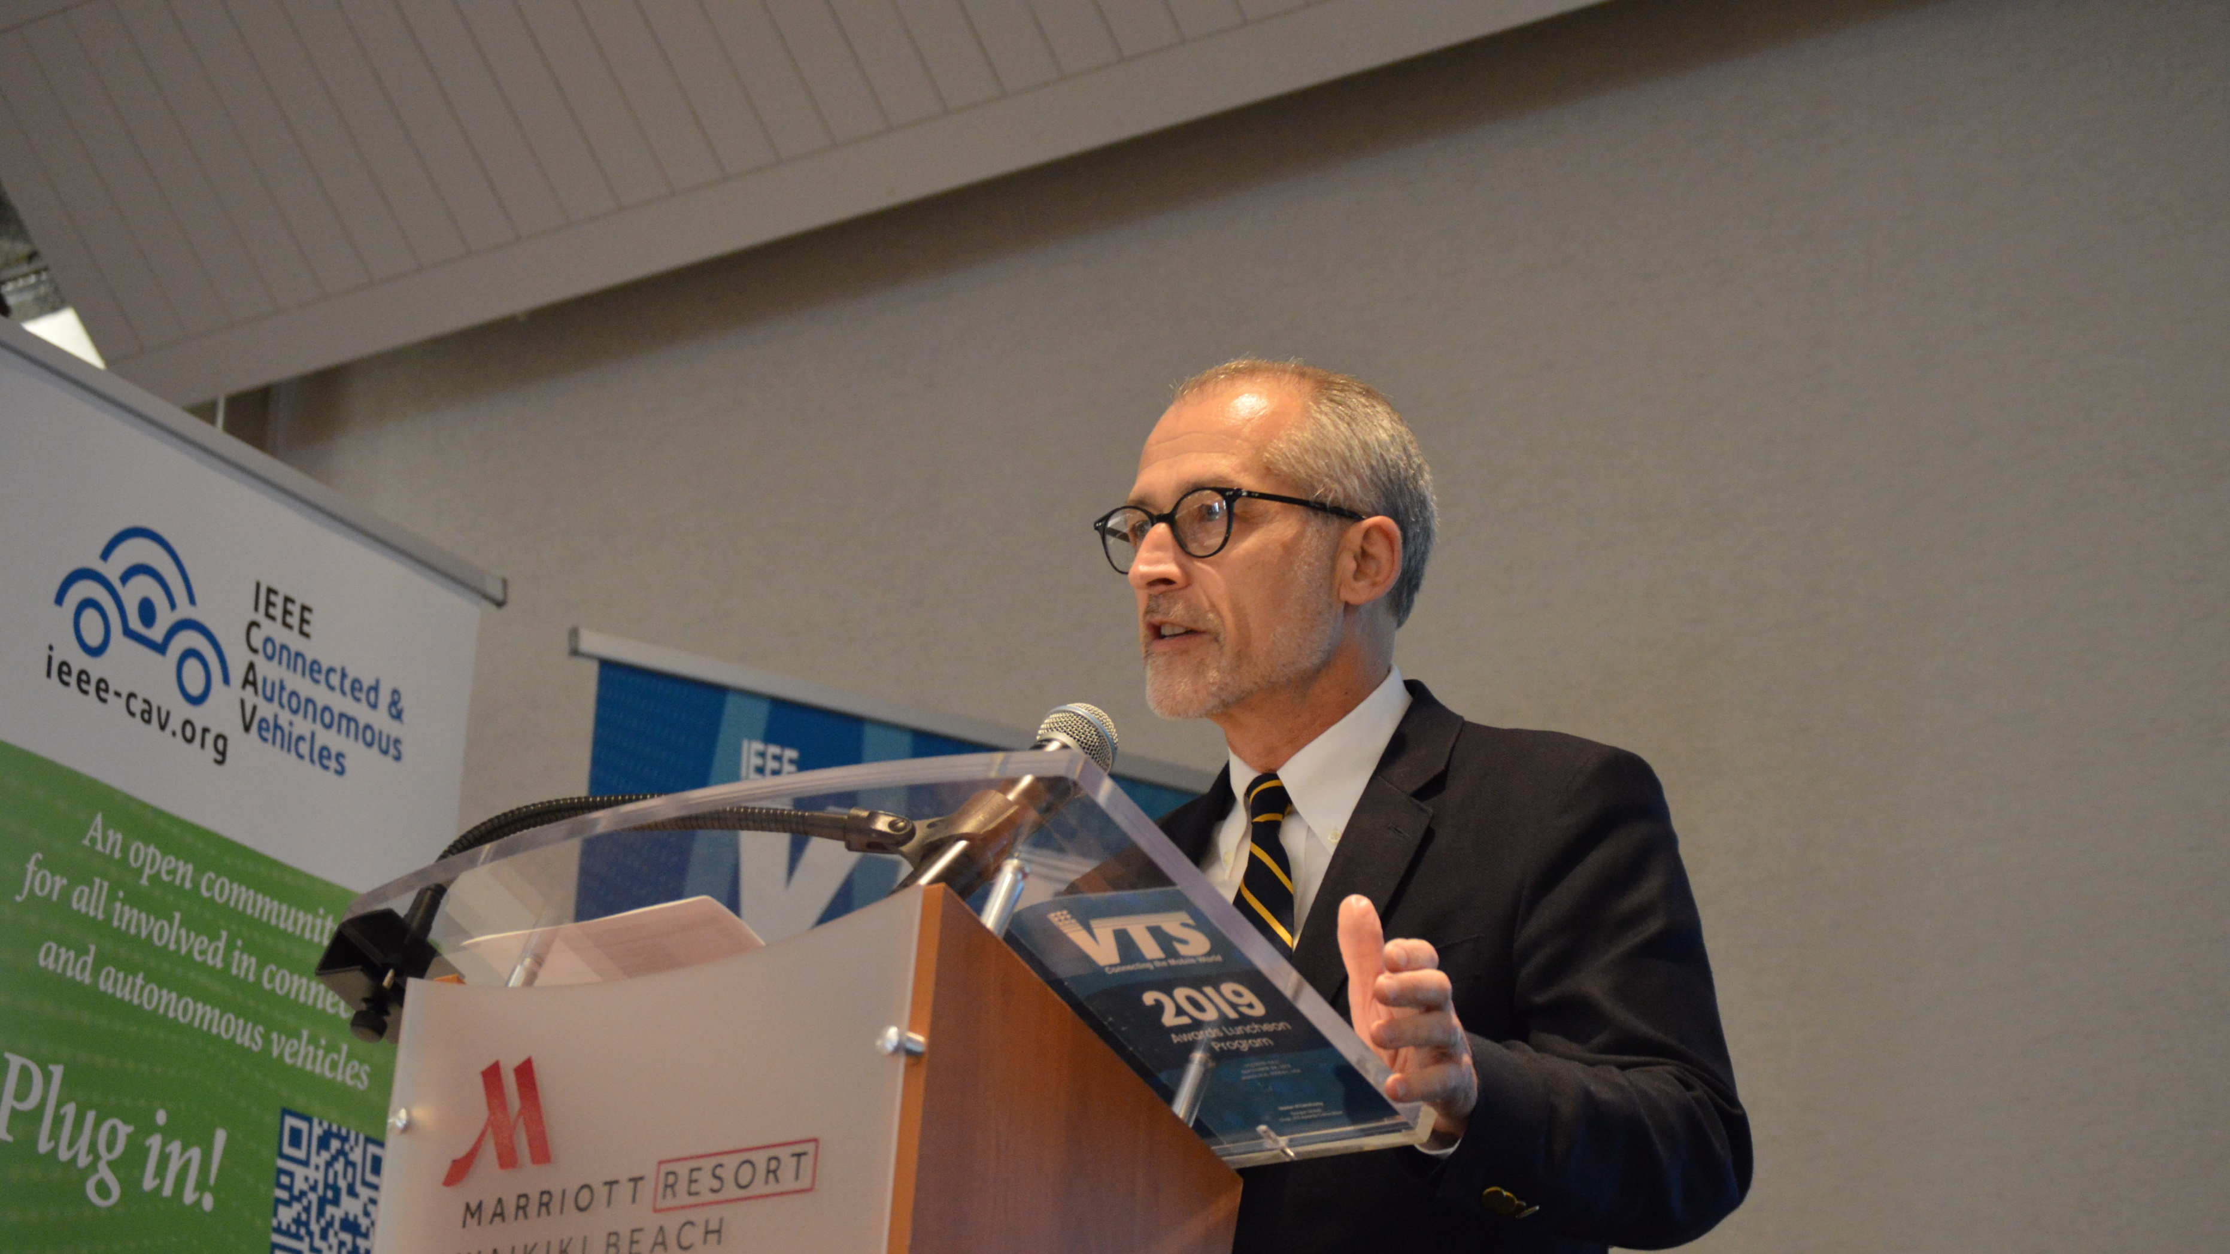
Notes:
J.R. Cruz

Slide 4
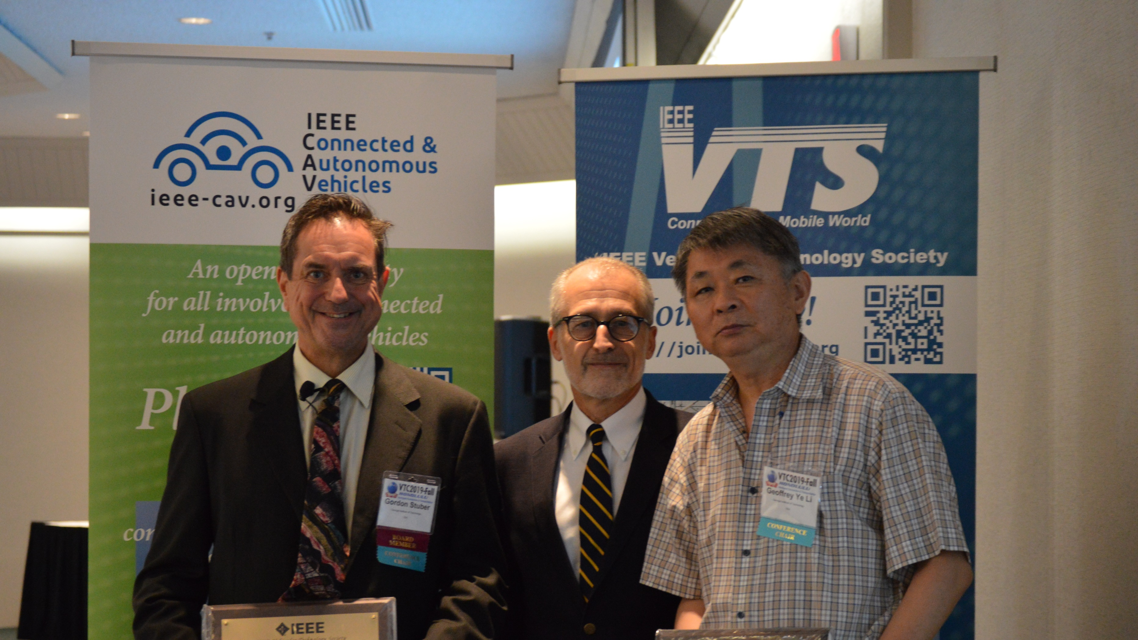
Notes:
J.R. Cruz presents Gordon Stuber and Geoffrey Ye Li, Conference General Co-chairs, with the Vehicular Technology Conference Award for exemplary contributions to the success fo the 2019 IEEE 90th Vehicular Technology Conference, VTC2019-Fall, held in Honolulu, HI

Slide 5
Notes:
Gordon Stuber, General Co-chair

Slide 6
Notes:
Geoffrey Li, General Co-chair

Slide 7
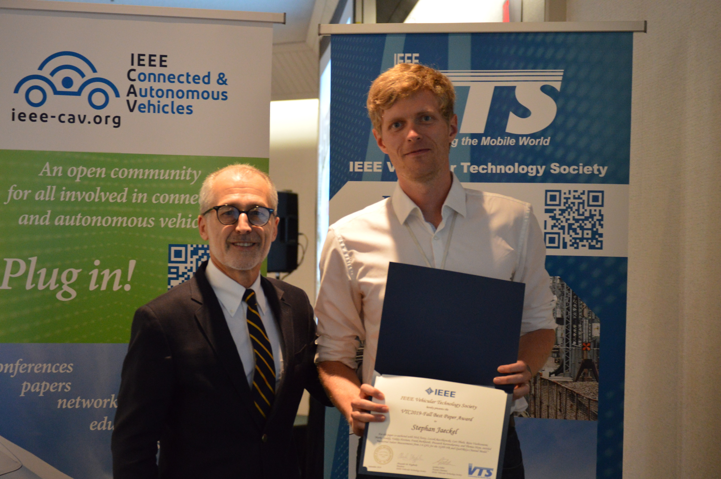
Notes:
J.R. Cruz presents the Best Paper Award for the VTC2019-Fall to Stephen Jaeckel (pictured) and his co-authors, Nick Turay, Leszek Raschkowski, Lars Thiele, from Fraunhofer Heinrich Hertz Institute, Risto Vuohtoniemi, Marko Sonkki, Veikko Hovinen, from university of Oulu, Frank Burkhardt, Prasanth Karunakaran and Thomas Heyn, from Fraunhofer Institute for Integrated Circuits for their paper titled “Industrial Indoor Measurements from 2-6 GHz for the 3GPP-NR and QuaDRiGa Channel Model”.

Slide 8
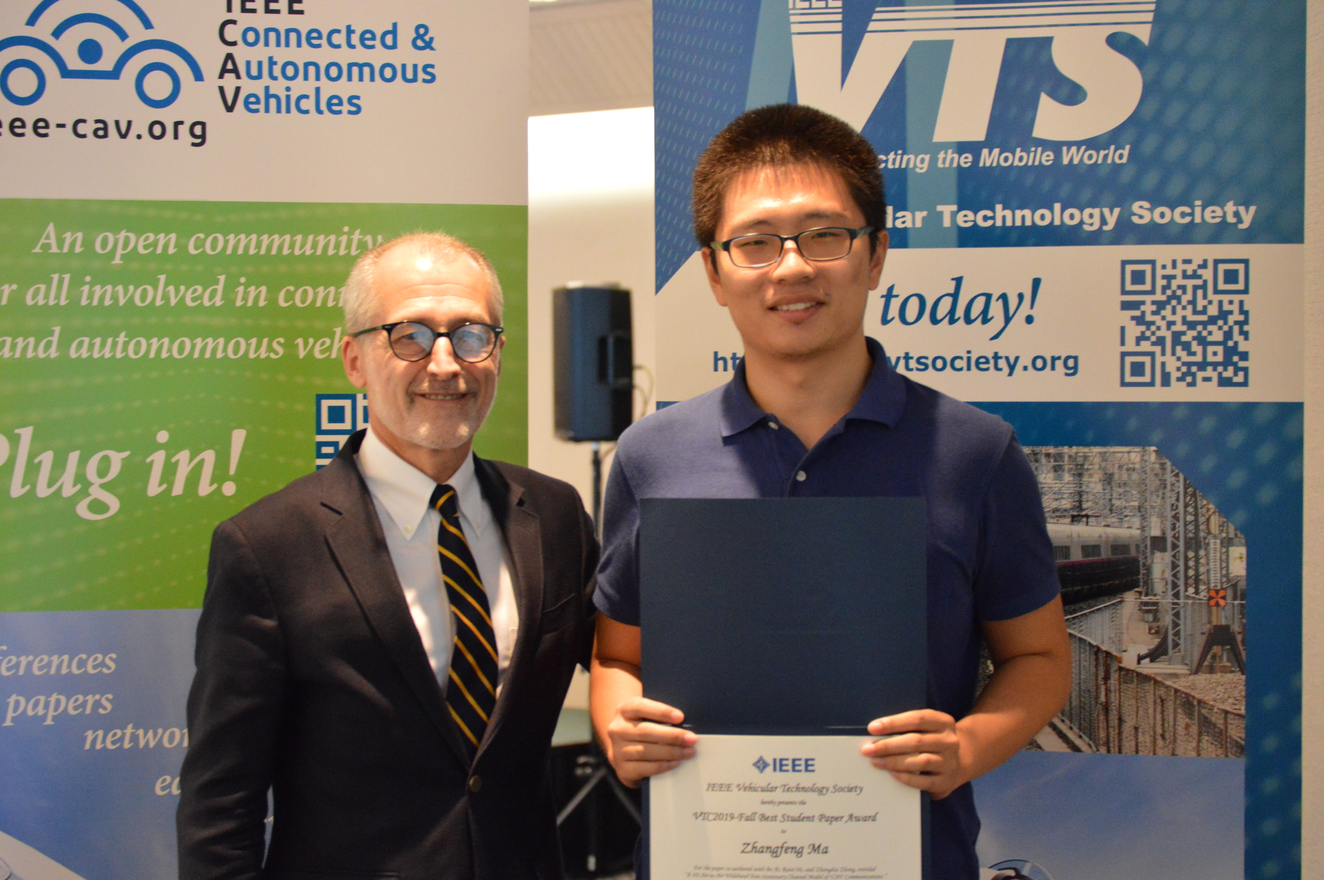
Notes:
J.R. Cruz presents the Best Student Paper Award for the VTC2019-Fall to Zhangfeng Ma (pictured), and his co-authors Bo Ai, Ruisi He, and Zhangdui Zhong from Beijing Jiaotong University for their paper titled “A 3D Air-to-Air Wideband Non-Stationary Channel Model of UAV Communications”.

Slide 9
Notes:
Gordon Stuber

Slide 10
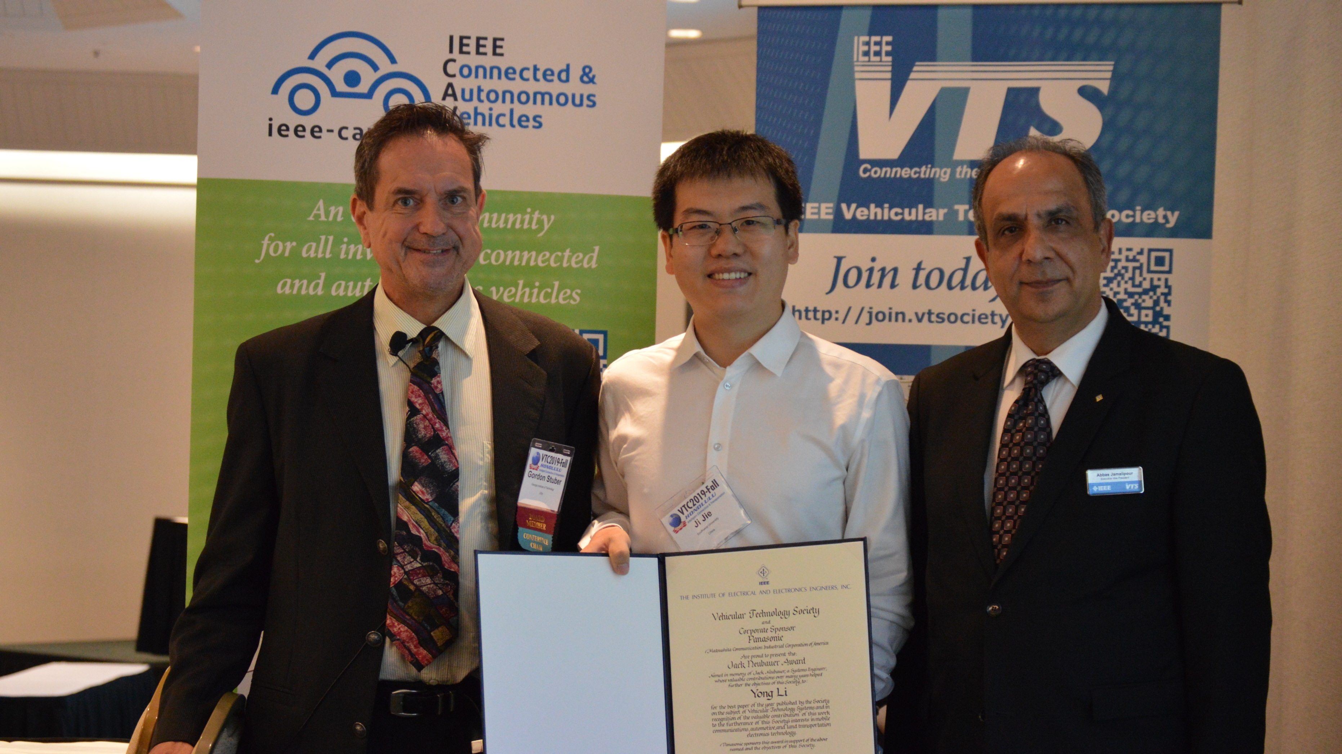
Notes:
Gordon Stuber, VTS Awards Committee Chair and Abbas Jamalipour, VTS Executive Vice President and Fellows Committee Chair present Yong Li (middle), and his co-authors, Xueshi Hou, Min Chen, Di Wu, Depeng Jin and Sheng Chen, with the Vehicular Technology Society Best Paper Award for their paper titled “Vehicular Fog Computing: A Viewpoint of Vehicles as the infrastructures,” IEEE Transactions on Vehicular Technology, Vol. 65, No. 6, pp.3860-3873, June 2016.

Slide 11
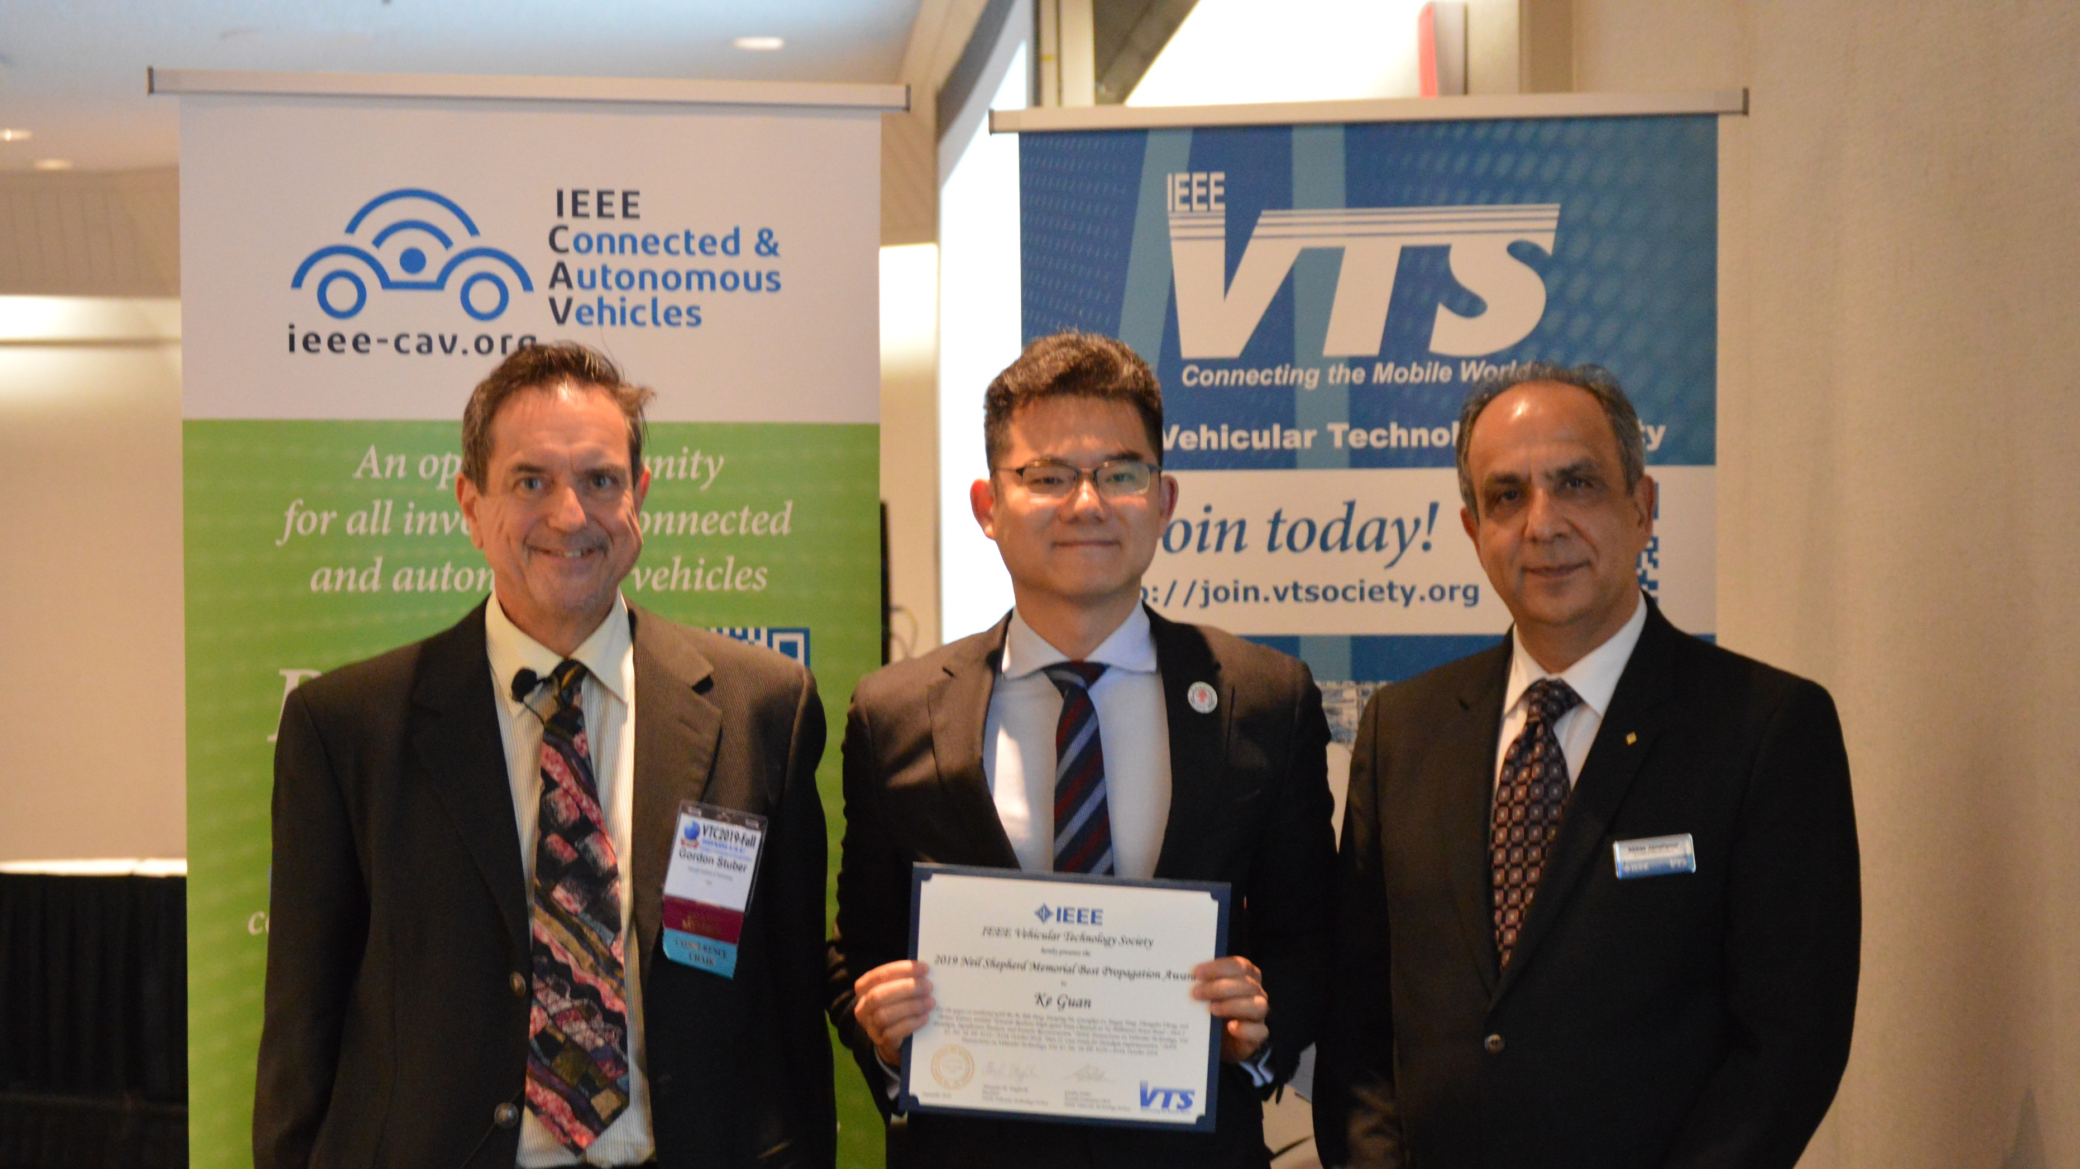
Notes:
Gordon Stuber, VTS Awards Committee Chair, and Abbas Jamalipour, VTS Executive Vice President and Fellows Committee Chair present the 2019 Neil Shepherd Memorial Best Propagation Award to Ke Guan (middle) and his co-authors Bo Ai, Bile Peng, Danping He, Guangkai Li, Jingya Yang, Zangdui Zhong, and Thomas Kürner for their paper titled “Towards Realistic High-Speed Train Channels at 5G Millimeter-Wave Band – Part 1: Paradigm, Significance Analysis, and Scenario Reconstruction”, IEEE Transactions on Vehicular Technology, Vol. 67, No. 10, pp.9112-9128, October 2018. “Part 2: Case Study for Paradigm Implementation,” IEEE Transactions on Vehicular Technology, Vol. 67, No. 10, pp. 9129-9144, October 2018.

Slide 12
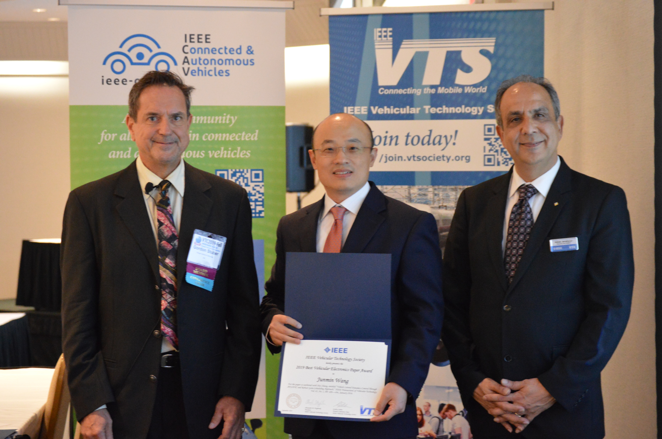

Slide 13
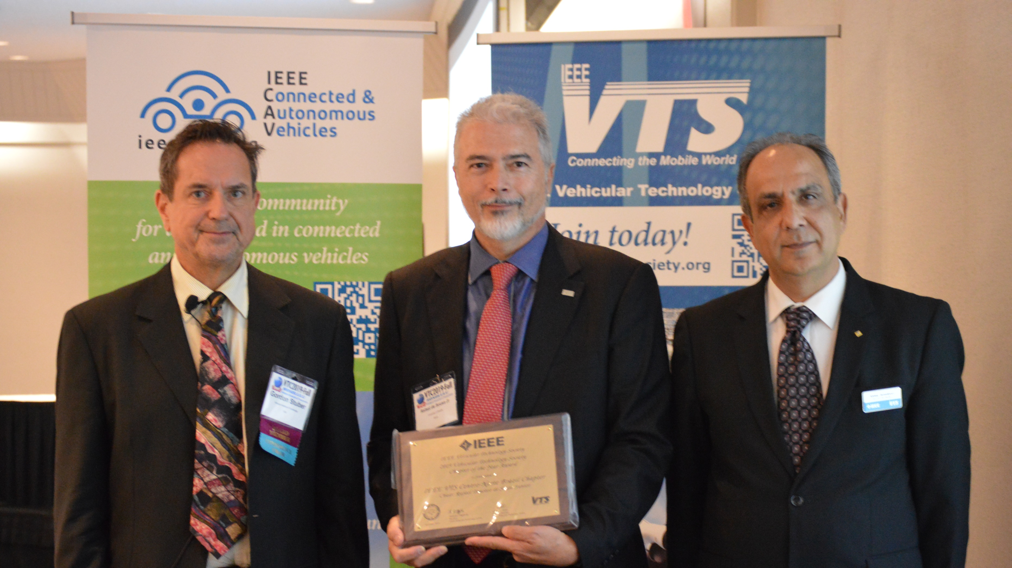

Slide 14
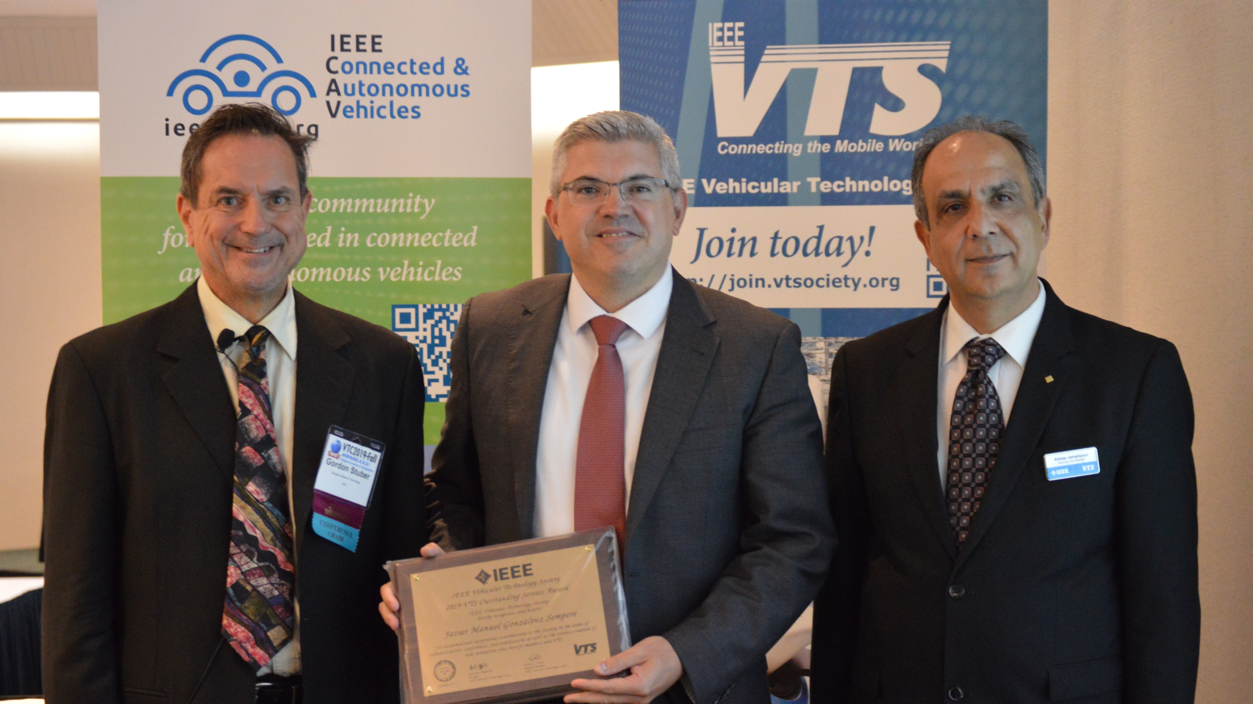

Slide 15
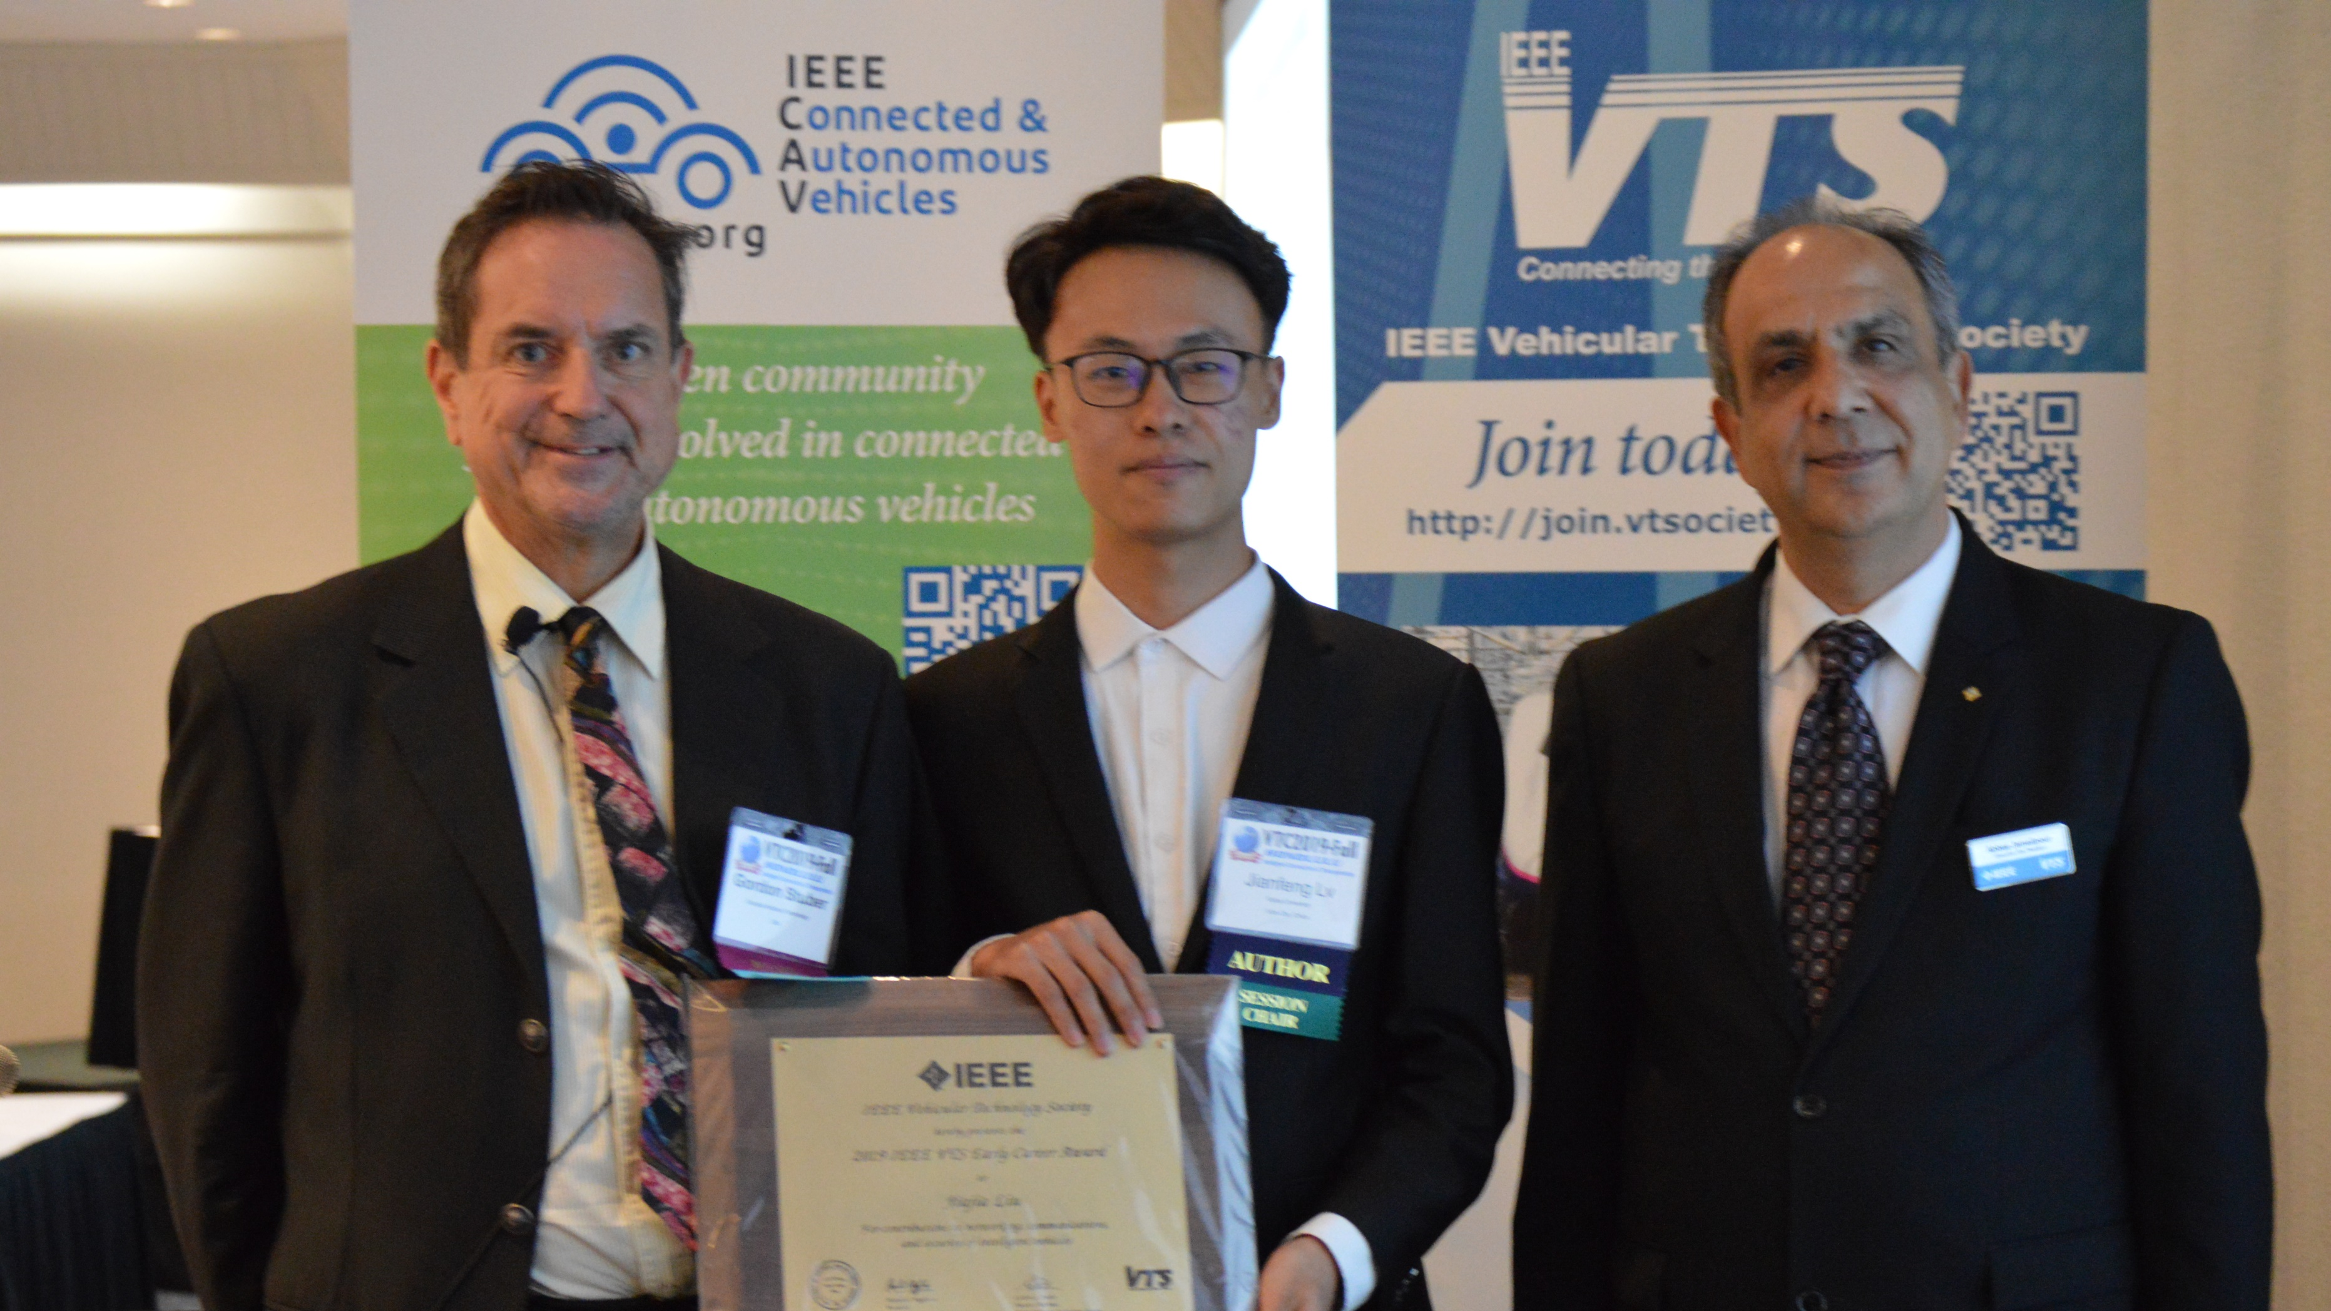

Slide 17
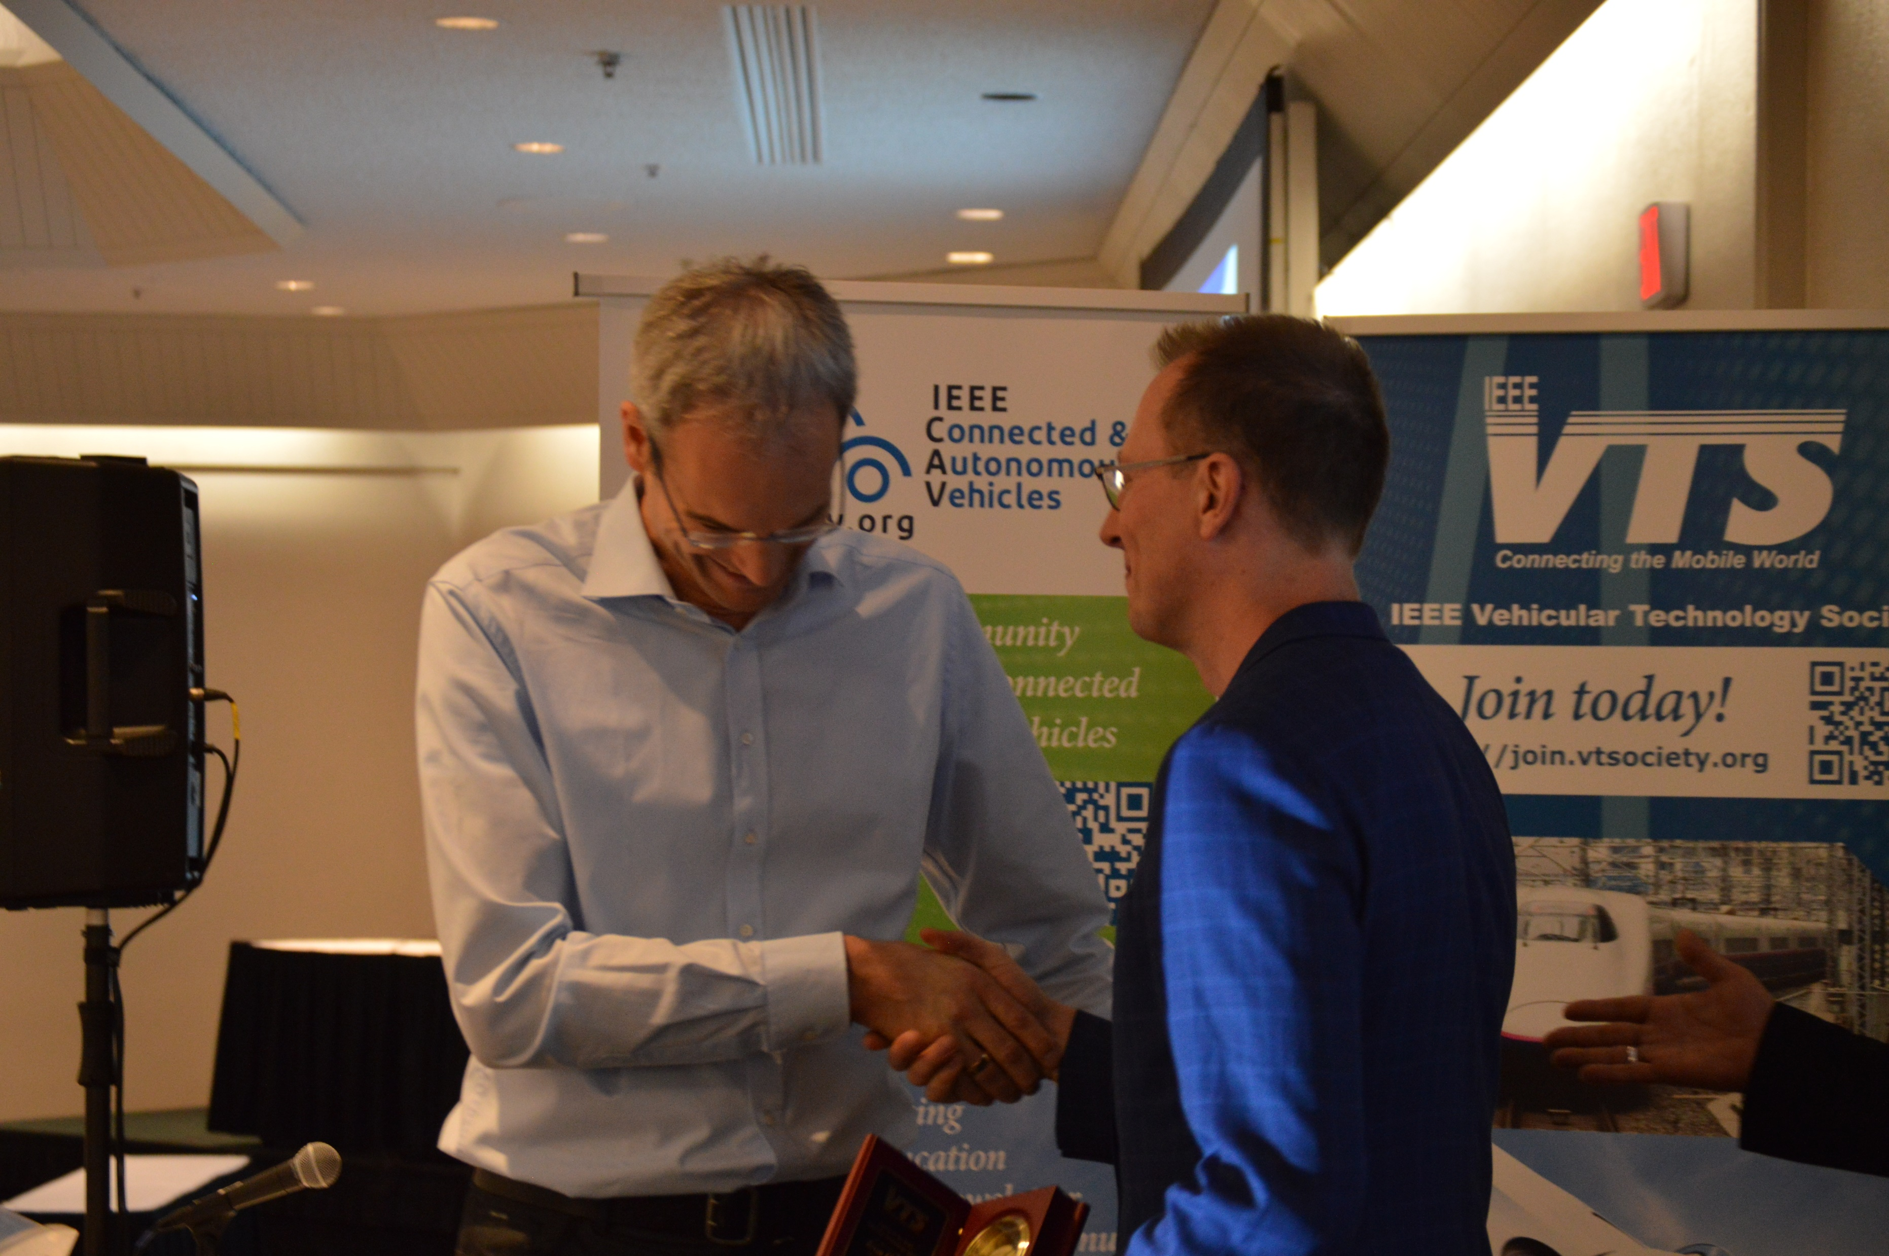

Slide 23
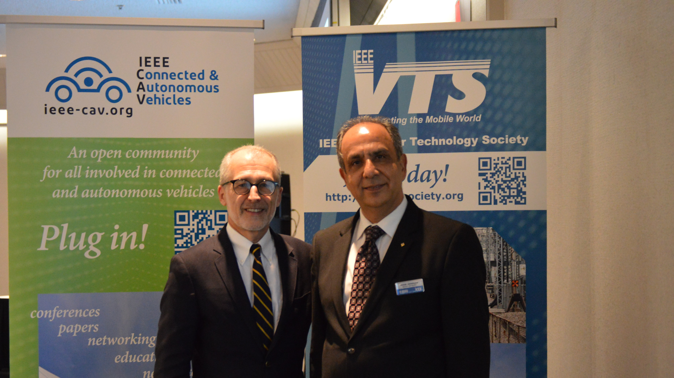

Slide 24
