Slide 1
Workshop on Diversity & Inclusion VTC2023-Spring
Florence, Italy
June 21, 2023 14:00-15:30

Slide 2
Co-chair: Carmela Cozzo, SAMSUNG, USA Co-chair: Sarah Kate Wilson, Santa Clara University, USA
Keynote speakers:
Ana Garcia Armada, Universidad Carlos III de Madrid (UC3M), Spain
Presentation title: Waveforms and Diversity
Chris Lewis, LEWISINSIGHT, UK
Presentation title: The telecoms inclusion opportunity: design for the edge and the centre comes for free
Lian Zhao, Toronto Metropolitan University (formerly Ryerson University), Canada
Presentation title: Women in Engineering: to have a successful professional career
Sarah Kate Wilson, Santa Clara University, USA
Presentation title: Facts vs. myths for women in engineering
The workshop includes a Panel on “Designing for Diversity”
This workshop will be presented in hybrid mode

Slide 3
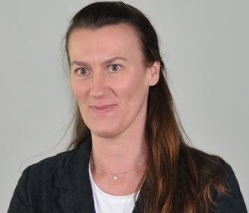
Carmela Cozzo
Bio: Carmela Cozzo is a Principal Engineer and Standards Expert at Samsung. She has over 20 years of experience in research and standardization of wireless communications systems in leading telecommunications companies. She has been actively contributing to the 3GPP standardization of 5G/4G/3G systems as RAN1 and RAN delegate and rapporteur representing Samsung, and earlier Huawei. She was with Ericsson Research where she focused on algorithm design of advanced receivers for HSPA systems. She holds a Ph.D. in EE from North Carolina State University, and a Laurea degree in EE from the University of Rome, Italy.
She is a Senior Member of IEEE, served as editor of the IEEE Transaction on Vehicular Technologies and as reviewer of major IEEE journals and conferences. She is the IEEE VTS Liaison to IEEE Women in Engineering Committee, and Chair of the IEEE VTS Committee on Women in VTS and Diversity. She holds several patents, has authored several IEEE papers and contributed to workshops/panels in wireless communications.

Slide 4
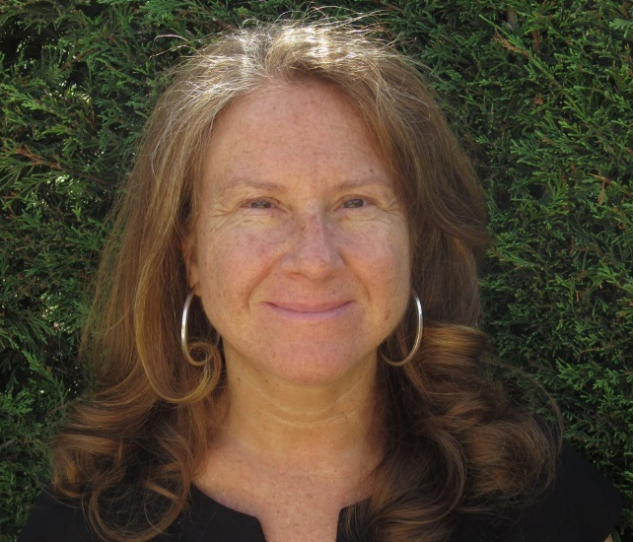
Ana Garcia Armada
Presentation title: Waveforms and Diversity
Bio: Ana Garcia Armada is a Professor at Universidad Carlos III de Madrid (UC3M), Spain. She has been a visiting scholar at Stanford University, Bell Labs, and University of Southampton. She has published more than 250 papers in conferences and journals and she holds five patents. She serves on the editorial boards of IEEE Transactions on Communications, IEEE Open Journal of the Communications Society and ITU Journal on Future and Evolving Technologies. She has been a member of the organizing committee of several conferences, including IEEE Globecom 2021 as the General Chair. She has received several awards from UC3M, the third place Bell Labs Prize 2014, the outstanding service award from the IEEE ComSoc Signal Processing and Communications Electronics technical committee, the outstanding service award from the IEEE ComSoc Women in Communications Engineering standing committee and the IEEE ComSoc/KICS Exemplary Global Service Award. Her research mainly focuses on signal processing applied to wireless communications.

Slide 5
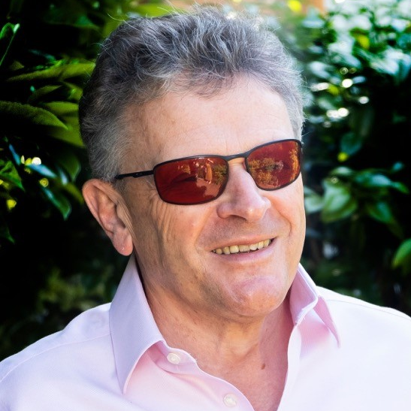
Chris Lewis
Presentation title:
The telecoms inclusion opportunity: design for the edge and the centre comes for free
Bio: Chris has covered all aspects of the global telecoms and adjacent industry sectors over 30 years working as an industry analyst with Logica, Ovum, Yankee Group and IDC as well as independently under the Lewis Insight and Great Telco Debate banners for the last ten years. He offers a unique perspective on the emerging telecoms and networking markets and how they fit into the broader emerging digital landscape. He also works with the TM Forum, sits on the GSMA’s Mobile World Congress Advisory Board and acts as a judge for many industry bodies. Registered blind throughout his career and a leading user of assistive technology, Chris has now expanded his coverage to look at the area of Equality Diversity & Inclusion (EDI) and Inclusive Design and its importance as part of sustainability for the telecoms industry.
Chris also founded the Great Telco Debate which he established as a platform for more open and frank discussion on the future of the telecoms industry. The most recent debates topics include the Telcos progress towards being a digital service provider, Open RAN dividing loyalties, Cloudification and Softwarization of the Telco, Private Wireless Networks and 6G & the Metaverse.
Chris is a frequent public speaker at industry and client events around the world. His dynamic and engaging presentation style, coupled with in-depth industry knowledge, has resulted in keynote addresses, chairing panels, workshop facilitation and coaching of high level executives at many of the world's top telcos and ICT companies.

Slide 6
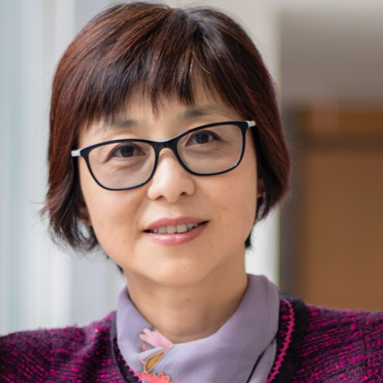
Lian Zhao
Presentation title:
Women in Engineering: to have a successful professional career
Bio: Lian Zhao received the Ph.D. degree from the Department of Electrical and Computer Engineering, University of Waterloo, Canada, in 2002. She joined Toronto Metropolitan University (formerly Ryerson University), Canada, in 2003. She has been an IEEE Communication Society (ComSoc) and IEEE Vehicular Technology (VTS) Distinguished Lecturer (DL); received the Best Land Transportation Paper Award from IEEE Vehicular Technology Society in 2016, Top 15 Editor Award in 2016 for IEEE Transaction on Vehicular Technology, Best Paper Award from the 2013 International Conference on Wireless Communications and Signal Processing (WCSP), Canada Foundation for Innovation (CFI) New Opportunity Research Award in 2005, and Outstanding New Leader Award from IEEE Toronto Section in 2021, IEEE Outstanding Leadership Award in 2018.
She has been serving as an Editor for IEEE Transactions on Wireless Communications, IEEE Internet of Things Journal, and IEEE Transactions on Vehicular Technology (2013-2021). She served as a co-Chair of Wireless Communication Symposium for Globecom 2020 and IEEE ICC 2018; Finance co-Chair for 2021 ICASSP; Local Arrangement co-Chair for IEEE VTC Fall 2017 and IEEE Infocom 2014; co-Chair of Communication Theory Symposium for IEEE Globecom 2013. She has been an elected Board of Governor (BoG) committee member since 2023. She has severed as a panel expert in various federal, provincial, and international evaluation committees.

Slide 7
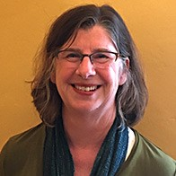
Sarah Kate Wilson
Presentation title: Facts vs. myths for women in engineering
Bio: Sarah Kate Wilson earned her A.B. from Bryn Mawr College with honors in Mathematics in 1979 and her Ph.D. from Stanford University in Electrical Engineering in 1994. She has worked in both industry and academia. She is a Professor of Electrical and Computer Engineering at Santa Clara University. She has served as an Editor for IEEE Transactions on Wireless Communications, IEEE Communications Letters and IEEE Transactions on Communications and the Editor-in-Chief of IEEE Communications Letters. She served as the Director of Journals 2012-2013 and the Vice-President of Publications 2014-2015 for the IEEE Communications Society. She has served as the Chair of the IEEE Teaching Awards Committee and is currently serving on the IEEE Society and Council Review Committee. She was awarded the IEEE Communications Society for "sustained and innovative contributions to publications" and won the 2018 IEEE Education Society Harriet Rigas Award "for excellence in communications engineering, education and promoting equity."

